Slide 2
The new generation of Gradient Boosting

Slide 3
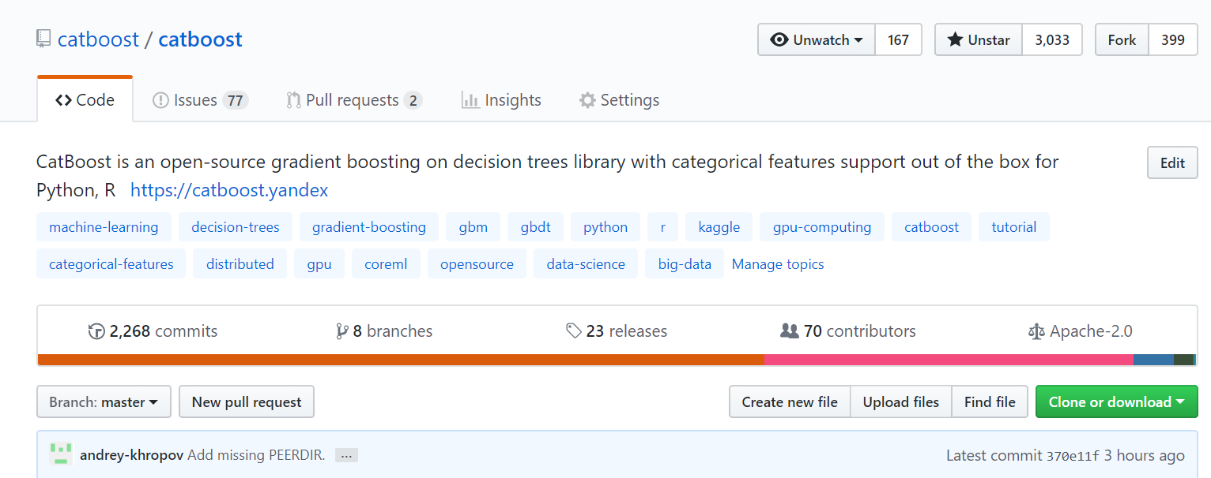
CatBoost

Slide 4
Gradient Boosting
    Best solution for heterogeneous data
    Easy to use
    Works well for small data

Slide 5
Applications
Medicine
Industry
Finance
Music and video recommendations
Sales prediction

Slide 6
Neural networks
Images
Sound
Text

Slide 7
NN + GB
Neural networks
Gradient boosting

Slide 8
Gradient boosting
+
+
+
+
…
Loss
Loss
Loss

Slide 9
Algorithm comparison
 | CatBoost | LightGBM |  | XGBoost |  | H2O
Adult | 0.269741 | 0.276018 | + 2.33 % | 0.275423 | + 2.11% | 0.275104 | + 1.99%
Amazon | 0.137720 | 0.163600 | + 18.79 % | 0.163271 | + 18.55% | 0.162641 | + 18.09%
Appet | 0.071511 | 0.071795 | + 0.40 % | 0.071760 | + 0.35% | 0.072457 | + 1.32%
Click | 0.390902 | 0.396328 | + 1.39 % | 0.396242 | + 1.37% | 0.397595 | + 1.71%
Internet | 0.208748 | 0.223154 | + 6.90 % | 0.225323 | + 7.94% | 0.222091 | + 6.39%
Kdd98 | 0.194668 | 0.195759 | + 0.56 % | 0.195677 | + 0.52% | 0.195395 | + 0.37%
Kddchurn | 0.231289 | 0.232049 | + 0.33 % | 0.233123 | + 0.79% | 0.232752 | + 0.63%
Kick | 0.284793 | 0.295660 | + 3.82 % | 0.294647 | + 3.46% | 0.294814 | + 3.52%

Slide 10
Symmetric trees
Height > 170
Height > 170
Weight > 65
Weight > 65
Weight > 65
Age > 16

Slide 11
Numerical features
Yes
Height > 170 cm?
No

Slide 12
Categorical features
Engineer
Categorical data
Designer
Occupation
Writer
Manager
HR

Slide 13
Categorical features support
    One-hot encoding
    Statistics based on category and category plus label value
    Usage of several permutations
    Greedy constructed feature combinations
SDE
1
SDE
1
SDE
0
PR
i
SDE
1
PR
1 + 1 + 0 + a * Prior
i
3 + a

Slide 14

Classical boosting
leafValue =
$$\sum_{i=1}^{n}{\begin{aligned}\text{g}\text{(}\text{approx}\text{(}\text{i}\text{), }\text{target}\text{(}\text{i}\text{))} \\ n\end{aligned}}$$

Slide 15

Ordered boosting
leafValue(doc) =
$$\sum_{i=1}^{doc}{\begin{aligned}\text{g}\text{(}\text{approx}\text{(}\text{i}\text{), }\text{target}\text{(}\text{i}\text{))} \\ docs in the past\end{aligned}}$$

Slide 16
Modes
    Classification
    Regression
    Ranking

Slide 17
Classification
    Predict if the person will pay the credit
    Which type of clouds will be present tomorrow

Slide 18
Regression
    Predict the taxi drive duration
    Predict dollar exchange rate

Slide 19
Ranking
    What are top N hotels in Tel Aviv?
    Input data: ratings
    Predicting rating is not necessary!
    Ranking within a group
    Ranking modes:
          Ranking (YetiRank, YetiRankPairwise)
          Pairwise (PairLogit, PairLogitPairwise)
          Ranking + Classification (QueryCrossEntropy)
          Ranking + Regression (QueryRMSE)
          Select top 1 candidate (QuerySoftMax)

Slide 20
Speed
    CPU training
    GPU training
    Prediction speed

Slide 21
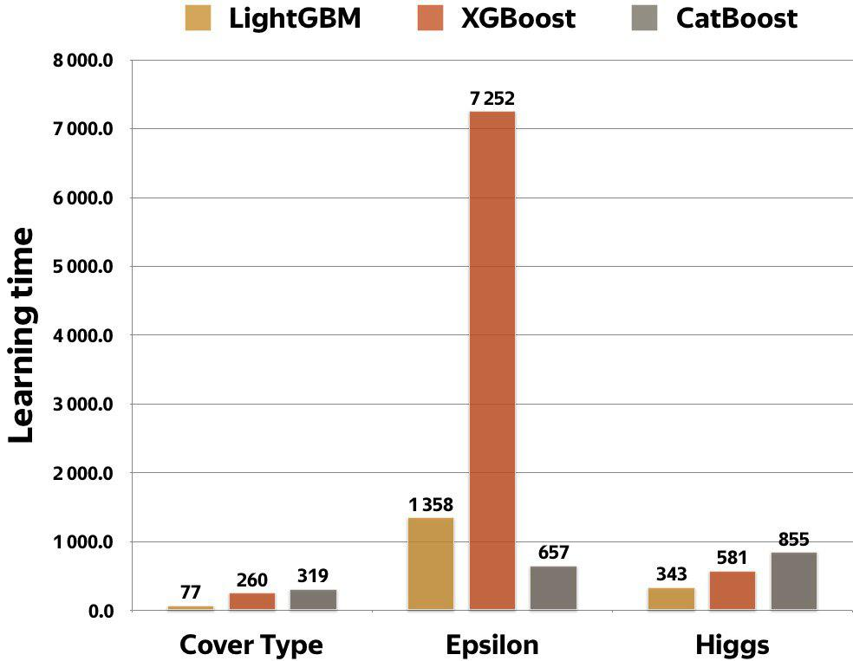
CPU: Comparison with other libraries
  Parameters:
  128 bins, 64 leafs, 1000 iterations
  Cover type:
  54 features, 522910 samples
  Epsilon:
  2000 features, 400k samples
  Higgs:
  28 features, 11M samples
  Intel(R) Core(TM) i7-6800K CPU @ 3.40GHz

Slide 22
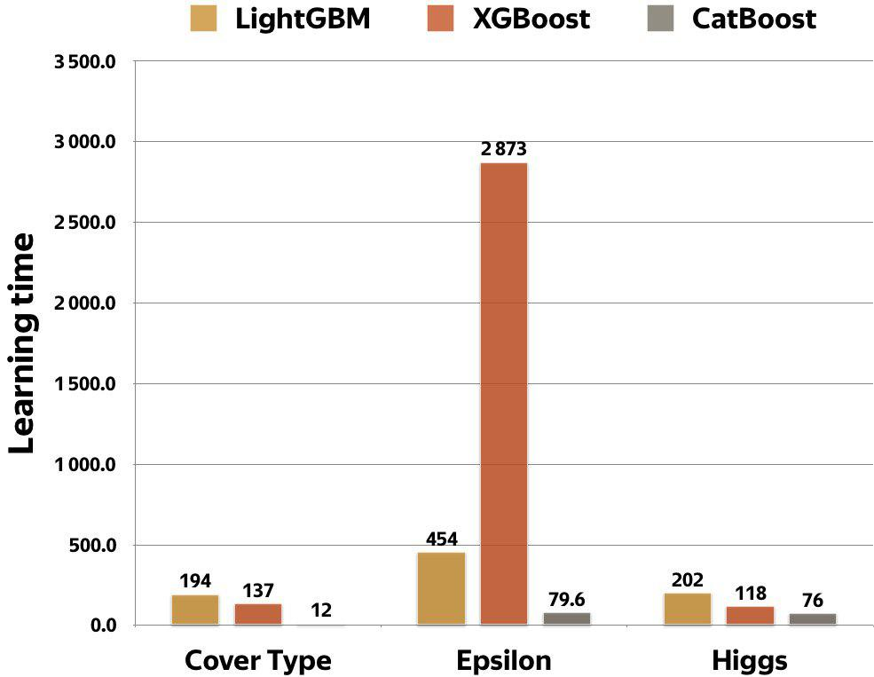
GPU: Comparison with other libraries
  Parameters:
  128 bins, 64 leafs, 1000 iterations
  Cover type:
  54 features, 522910 samples
  Epsilon:
  2000 features, 400k samples
  Higgs:
  28 features, 11M samples
  GTX1080Ti

Slide 23
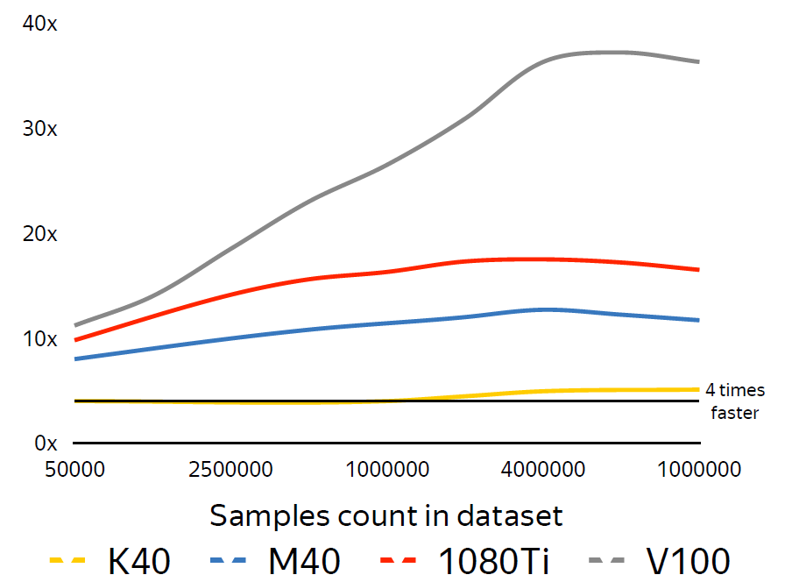
CPU vs GPU
  Dual-Socket Intel Xeon E5-2660v4 as baseline
  Several modern GPU as competitors
  Dataset: 800 features

Slide 24
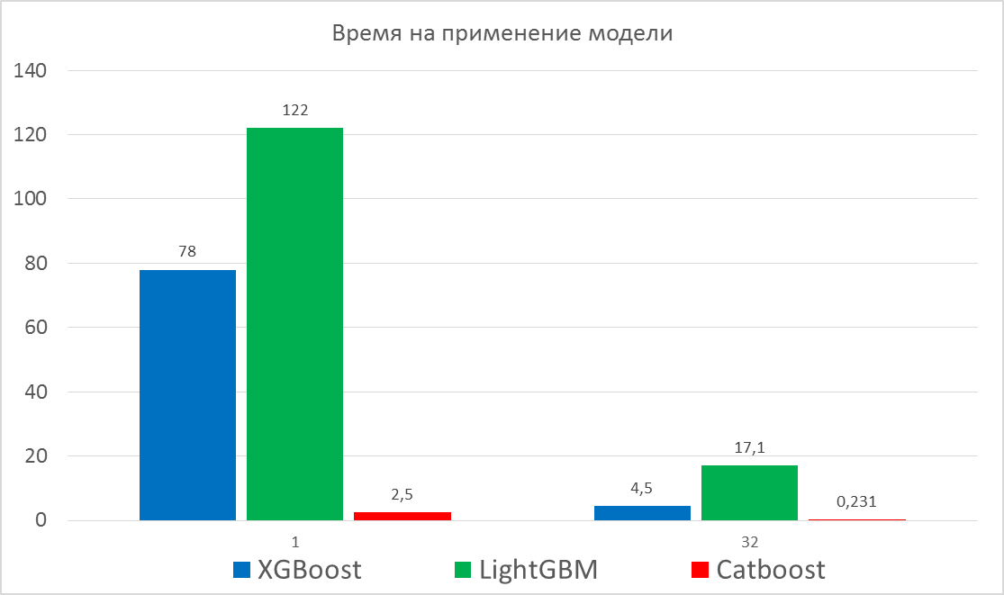
Prediction time

Slide 25
Ways to explore your data
    Feature importance
    Feature interaction
    Per object feature importance (SHAP)

Slide 26
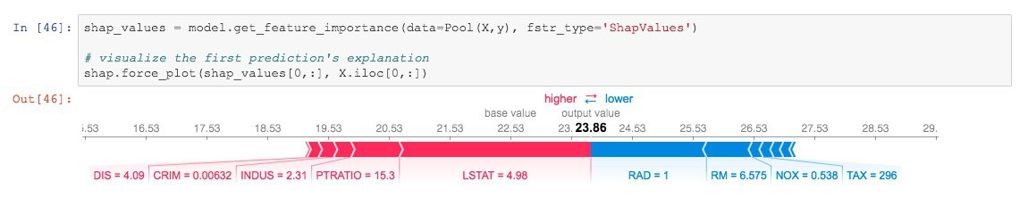
SHAP values

Slide 27
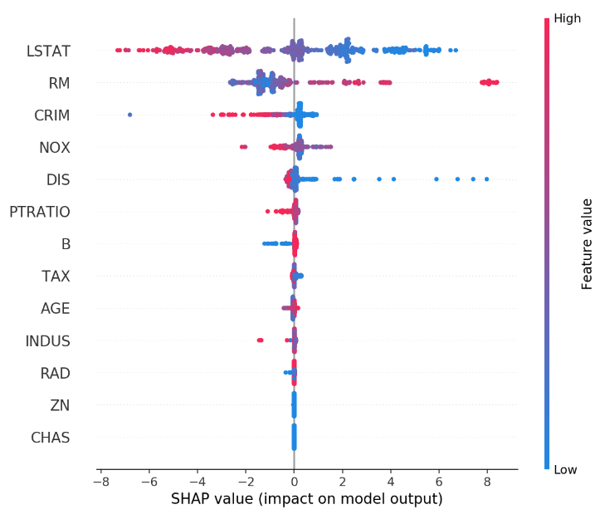
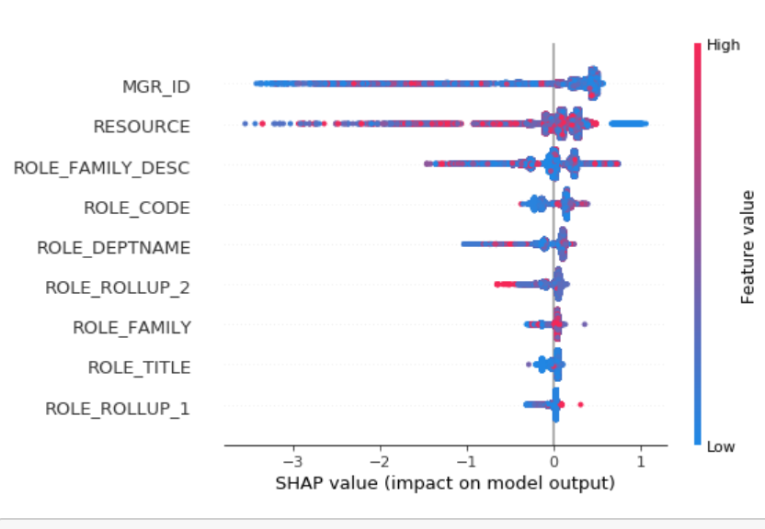
SHAP values

Slide 28
Ways to explore your data
    Feature importance
    Feature interaction
    Per object feature importance (SHAP)
    Influential documents
    New features evaluation

Slide 29
Useful features
    Overfitting detector
    Metric evaluation during training

Slide 30
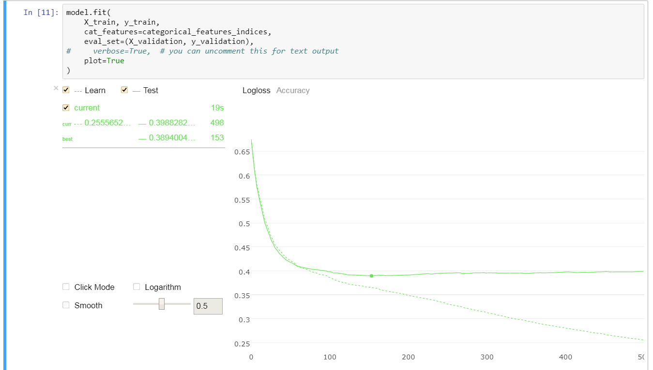
CatBoost Viewer

Slide 31
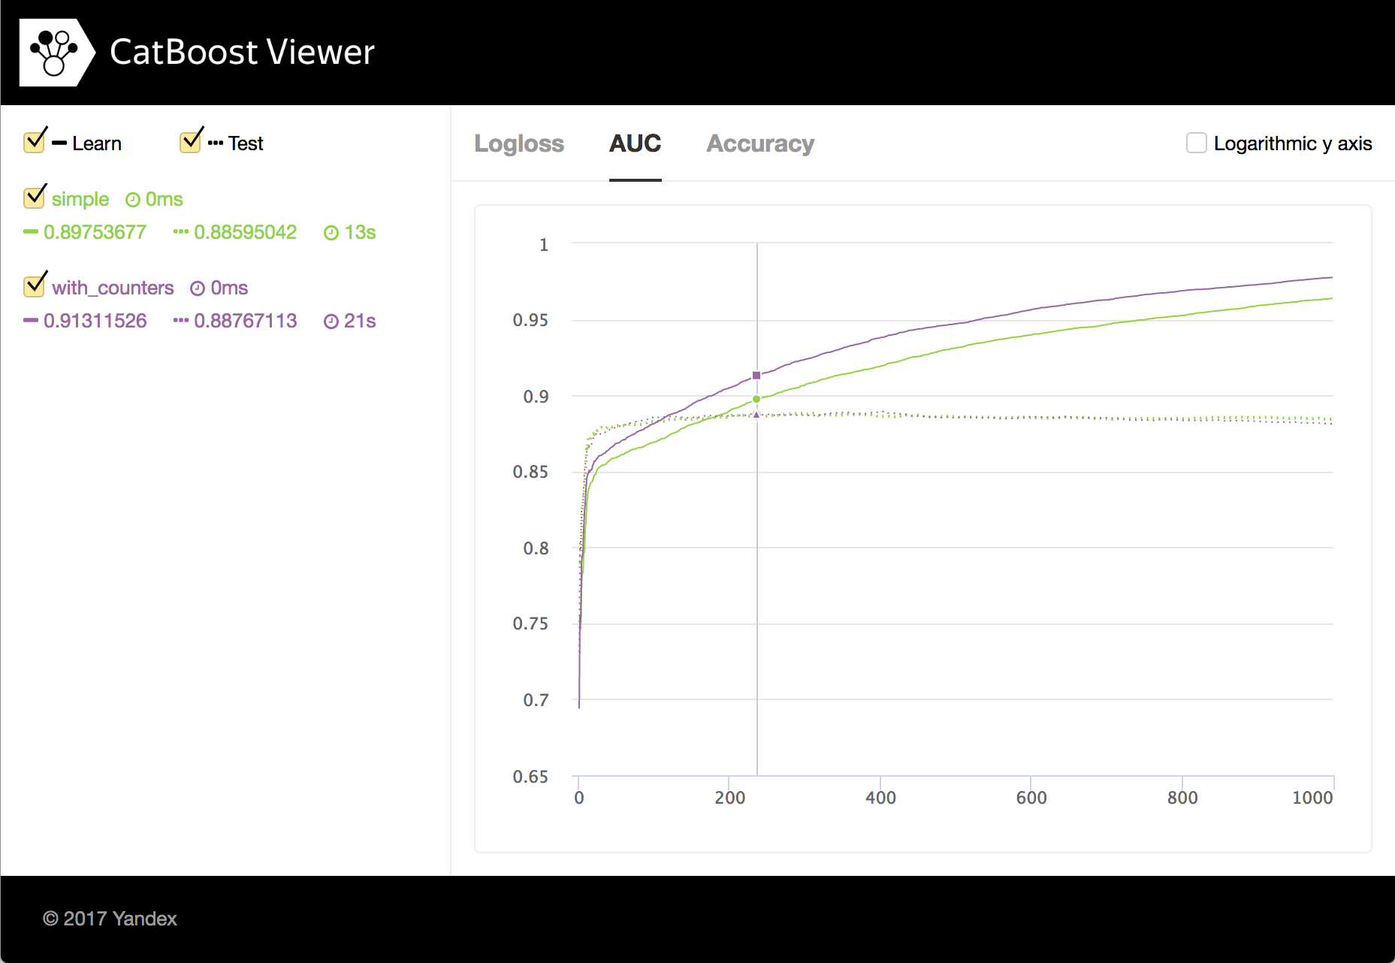
CatBoost Viewer

Slide 32
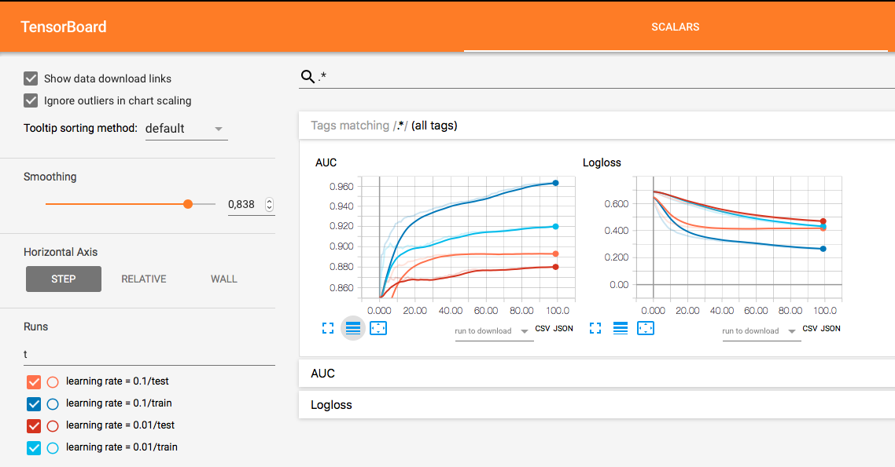
TensorBoard

Slide 33
Useful features
    Overfitting detector
    Metric evaluation during training
    Missing values support
    Cross-validation

Slide 34
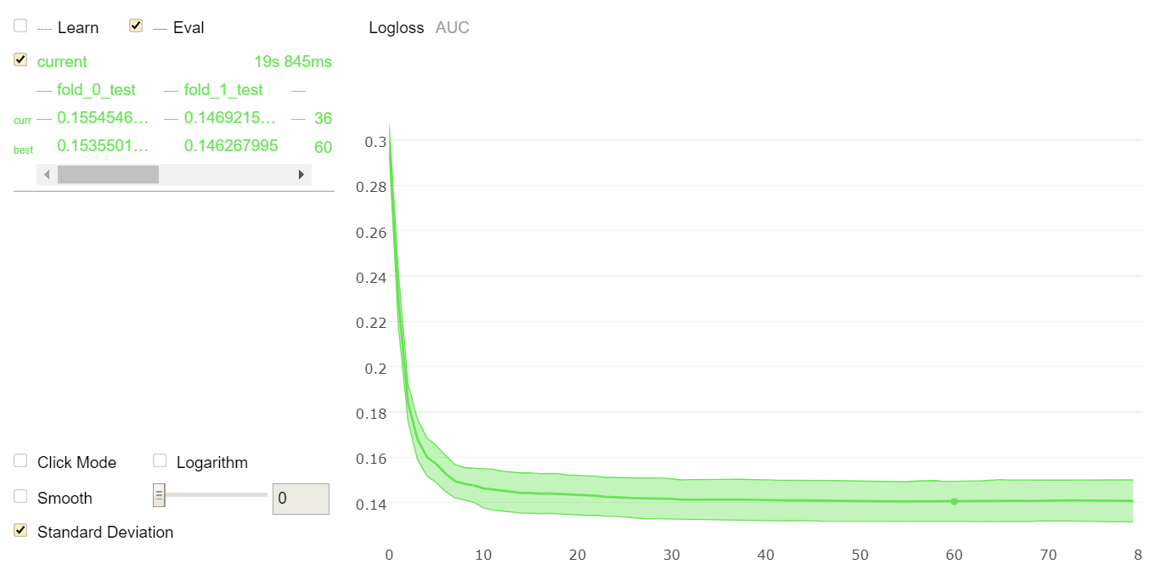
Cross-validation

Slide 35
Useful features
    Overfitting detector
    Metric evaluation during training
    Missing values support
    Cross-validation
    staged_predict + metric evaluation on dataset

Slide 36
Algorithm parameters
    learning_rate + iterations
    depth
    l2_regularization
    bagging_temperature
    random_strength

Slide 37
Reading
    http://learningsys.org/nips17/assets/papers/paper_11.pdf
    https://arxiv.org/abs/1706.09516
    https://github.com/catboost/tutorials

Slide 38

Questions?
Anna Veronika Dorogush
http://catboost.yandex
Lead of CatBoost team

